Slide 1
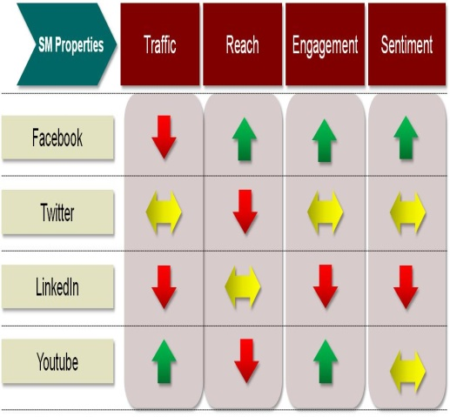
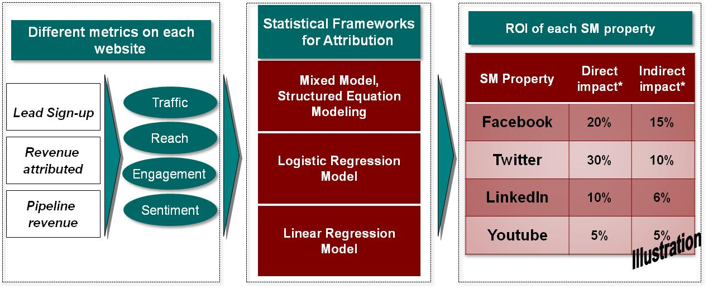
Mu Sigma determined the ROI of Social Media efforts for a large technology retailer
Social Media Analytics- ROI
Background
Insights/Recommendations
The Client is a Fortune 500 IT solutions company
The Client has active social media presence in various online communities (internal, external) where they engage with members, participate in discussions, post downloadable content, address queries etc.
The Client wants Mu Sigma to determine the ROI of their social media investments
Strong correlation was observed between KPIs and revenue obtained from the properties
Average revenue & repurchase rate from customers present in social media is higher than that of customers not present in social media vehicles
Illustration
Analytical Approach
Improved marketing efforts and corresponding ROI by investing in the right social media properties
The statistical model helped in identifying sub drivers of revenue within each community, thereby helping business develop strategies for specific communities as well
Business Impact

